Slide 1



Fine-Tuning BLIP for Stylistic Image Captioning
By Ritvik & Anuj
December 10, 2025

Slide 2
The Gap: From Generic to Stylistic Captioning
The Problem: Traditional image captioning models generate generic, factual descriptions (e.g., "A dog sitting on a couch").
The Goal: To generate captions that are visually accurate and align with specific stylistic preferences (e.g., funny, poetic, formal, neutral).
Our Solution: Fine-tuning a state-of-the-art VLP model (BLIP) and augmenting it with an explicit style control mechanism.

Slide 3
Foundation: Vision-Language Pre-Training (VLP)
CLIP (Contrastive Learning of Image Representations):
— Paradigm: Learning joint image-text embeddings via contrastive loss on a massive, web-sourced dataset.
— Key Feature: Established robust zero-shot transfer capabilities.
BLIP (Bootstrapping Language-Image Pre-training):
— Extension: Unified architecture for both understanding and generation tasks.
— Mechanism: Uses a bootstrapping mechanism that alternates between image-text matching/retrieval and generation objectives for joint optimization.

Slide 4
Style-Aware Methodology: Multi-Task Fine-Tuning
Core Strategy: Fine-tuning the pre-trained BLIP model on our style-annotated Instagram data.
Computational Efficiency: Employing Gradient Checkpointing to enable adaptation of the large BLIP model on resource-constrained hardware (trading computation time for memory efficiency).
Style Control (Multi-Task Learning):
— We attach specialized classifier heads to the fine-tuned BLIP representations.
— This performs multi-label style classification (neutral, funny, formal, poetic) as an auxiliary task.
— This dual objective provides explicit style supervision and improves the learned representations.

Slide 5
Leveraging Real-World Stylistic Variation: The Instagram Dataset
Data Source: Instagram image-caption pairs from the prithvijaunjale/instagramimages-with-captions Kaggle repository.
Key Difference from Benchmarks:
— MS COCO: Emphasizes factual accuracy and generic descriptions.
— Instagram: Captures authentic user communication, featuring: Informal Language and Creative Expressions.

Slide 6
Key Results and Practical Value
Stylistic Generation: The fine-tuned BLIP model successfully generates captions that match the visual content and adhere to the target style (neutral, funny, formal, poetic).
Performance: State-of-the-art performance is expected on the style-specific captioning task, validating the use of the unified BLIP architecture.
Implications: Improved Engagement + Content Creation

Slide 7
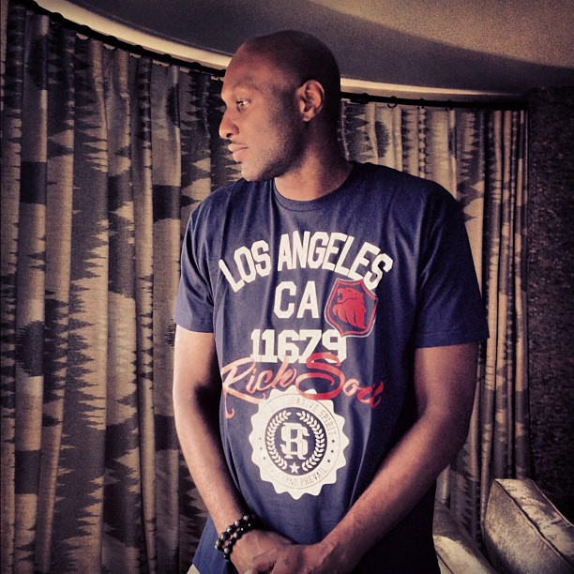
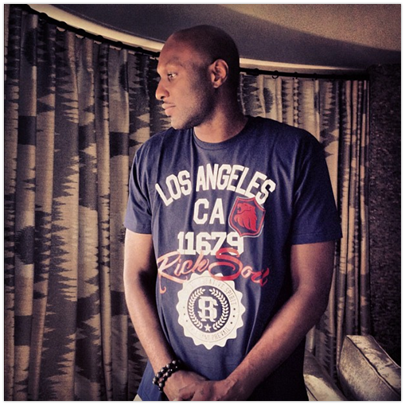
Demonstrating Style Control: The Output Difference
Our fine-tuned model
Traditional BLIP
“We don’t want this to just be a game”
“A bald man in a dark blue t-shirt stands near a curtain, looking to the side.”

Slide 8
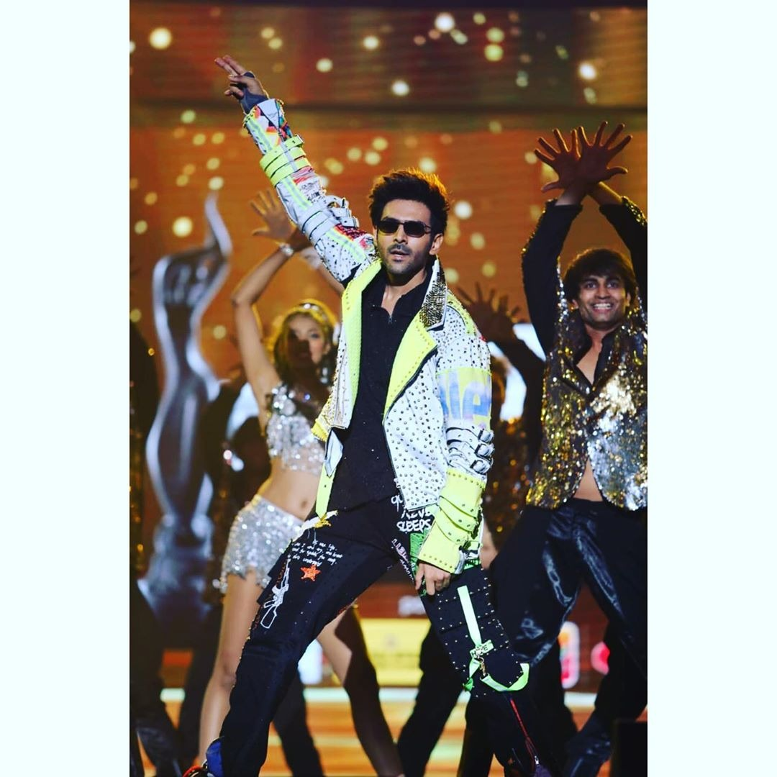
A Poetic Touch
“As long as you love me…”
“A male performer is dancing on a stage in front of a sparkling background.”

Slide 9
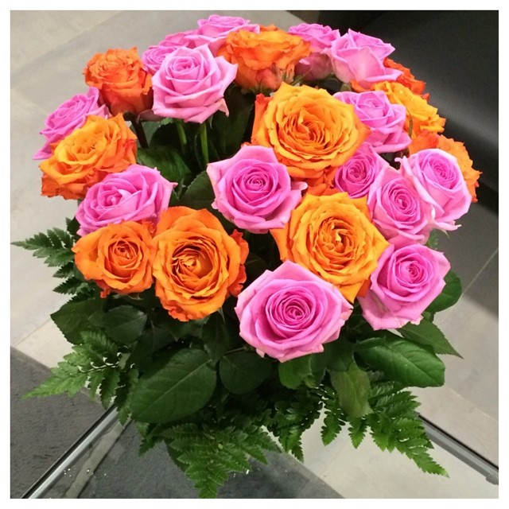
Neutral Captioning at its Best
“Happy Sunday”
“Pink and orange flowers surrounded by green ferns.”

Slide 10
Conclusion and Next Steps
This project successfully demonstrated that fine-tuning a unified VLP model (BLIP) with multi-task learning (style classification) is an effective and computationally efficient method for style-aware image caption generation on real-world social media data.
Expanding Style Space: Incorporating more nuanced stylistic dimensions beyond the initial four categories (e.g., sarcastic, motivational).
Evaluation: Developing more robust, human-centric evaluation methodologies for stylistic quality, as automatic metrics often fail to capture stylistic nuance.
Generalization: Extending these techniques to other multimodal tasks and platforms beyond Instagram.

Slide 11
THANK YOU!!!

